Slide 1
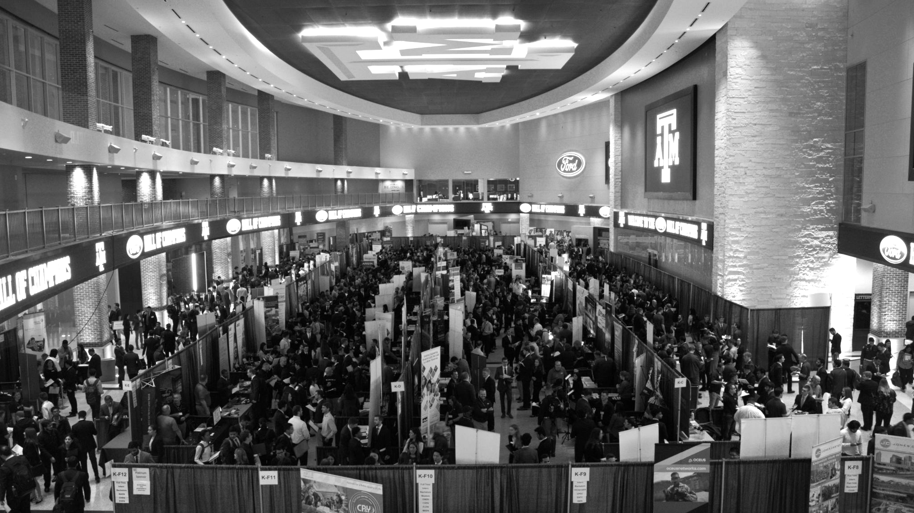

Final Presentation: Human Robotic Arm Attachment
Los Alamos National Laboratory 4/24
Team: Dalton Boeckmann, Izzy Baumler, Jade Waldron, Morgan Gullo

Slide 2
Agenda
Introduction
Problem
System Description
Analysis of Design
Broader Impacts of Design
Acknowledgements
Notes:
Our project is focused on developing a robotic arm solution to manage the radioactive waste stored at the Hanford Site in Washington State. This site has accumulated over 56 million gallons of waste stored in tanks that have far exceeded their intended lifespans. With the tanks now deteriorating, this poses serious environmental risks to local communities and ecosystems.
Problem Statement: "Our challenge at the Hanford Site revolves around removing radioactive waste in extremely confined spaces and under high-radiation conditions. The tanks holding this waste were designed to last only 25 years, yet many have far exceeded that lifespan, making the risk of leakage a pressing concern. Current solutions lack the needed durability, access capability, and flexibility for handling the solidified waste."
Project Objectives: "Our team’s primary objectives are to create a robotic arm capable of high mobility, durability, and efficiency for use in these restricted environments. We’re partnering with Los Alamos National Laboratory to bring this solution to life, and we're targeting a design that addresses all these challenges without risking human exposure to radiation."
Solution Approach: "Our proposed solution is a six-degree-of-freedom robotic arm mounted on a quadruped robot. This setup provides the stability needed for operations on uneven surfaces within the tanks. The 6-DoF arm, with its human-like mobility, will maneuver effectively within confined spaces to tackle both the liquid and solidified waste, ensuring efficient and comprehensive cleaning operations."
Key Challenges: "There are several critical obstacles our team is addressing: limited access due to one-foot-diameter tank openings, high radiation levels that damage equipment, and the need for rapid, remote operation. Many existing robotic systems can either manipulate or move quickly but struggle to do both effectively in a confined space. This project aims to fill that gap by providing both mobility and precise control within these extreme conditions."

Slide 3
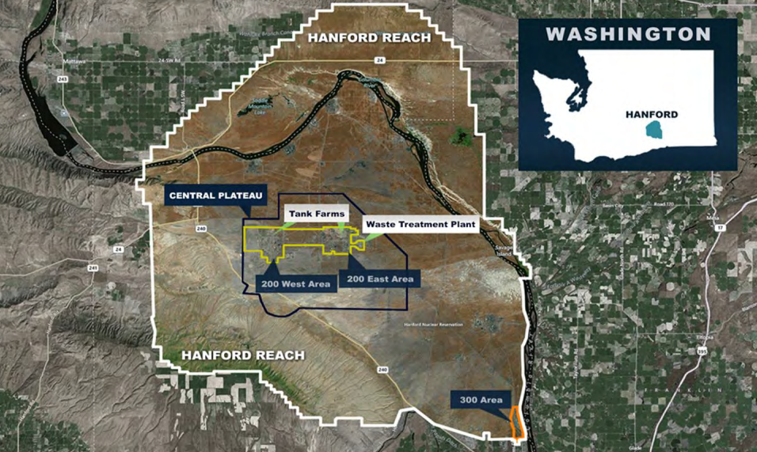
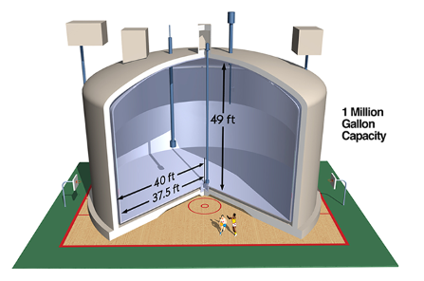
Problem Identification
Location: Hanford Site, Washington State
Background: 45+ years of plutonium production has led to 56+ million gallons of hazardous and radioactive waste stored at the Hanford Site.
Problem: Original tanks designed for 25 years; most now exceed this, with approximately 68 tanks in critical condition.
Risk: High environmental and health risks due to tank deterioration, posing a growing threat to surrounding areas.
Notes:
Our problem takes place…. Over its 45 years of plutonium production, the Hanford Site in Washington State has accumulated over 56 million gallons of mixed hazardous and radioactive waste. The waste was initially stored in tanks designed to last 25 years; however, most of these tanks have far exceeded their intended lifespans, with about 68 tanks reaching critical conditions. The state of these tanks poses an increasing threat to both local populations and infrastructure. Through the partnership with Los Alamos National Laboratory (LANL) and Texas A&M, our senior design team has been tasked to design and fabricate a solution for this problem.

Slide 4
Needs Analysis
I. Solution Neutral Problem Statement
II. Mission Statement

Slide 5
Solution Neutral Problem Statement
The Solution Neutral Problem Statement (SNPS) serves as the foundation for defining the project’s functionality and requirements.
By focusing on high-level project needs rather than specific solutions, the SNPS was derived.
The scope of the project and evolving custom requirements prompted regular revisions to the SNPS, ensuring ongoing alignment with project goals.
SNPS | There is a need for a technology that has 5 degrees-of-freedom and can move through 4 degrees-of-freedom of at least 1 Hz.
Customers | Department of Energy, National Research Laboratories
Notes:
In order to keep the project streamlined, the team identifies a snps to serve as the foundation of the projects functionality and requirement
This was used by focusing on high level project needs rather than specific solution, in order to allow for maximum possible solutions
Due to neutreality of this statement, it made it easy for iterative revisions, to ensure ongoing alignment with project hgoals
Finally, tyo date our snps, is as stated …, There is a need for a technology that has 6 DOF and can move through its full range of motion in each degree of freedom around 1 Hz.

Slide 6
Mission Statement
Mission statement to clarify the LANL project team’s design goals, aligning with both design team and customer needs.
The mission statement specifies that the LANL project team will design and prototype a 5 DoF robotic arm.
Mission Statement: Human Robotic Arm
Product Description | Design a 5 DoF robotic arm with human like functionality
Key Business or Humanitarian Goals | Effectively clean nuclear waste from Nuclear Waste Tanks to prevent contamination of local environments and populations Successfully Prototyped and Fabricate Robotic arm within 8 months
Primary Market | Department of Energy
Secondary Market | US Government, US Military, Nuclear Energy
Assumptions | We can assume: that the robot can withstand harsh radioactive environments, the robot can handle large amounts of force without tipping over, the robot can handle large amounts of force without damaging the tank wall, and visibility will allow for sensors to determine if plutonium is being removed, we assume the material is a hard tar heel substance
Stakeholders | Washington Citizens, National Research Labs, Department of Energy
Avenues for Creative Design | Material, robotic actuation for arm movement and control, Semi-Autonomous
Scope Limitations | Resources, only 4 group members, only 8 months to work on it, Size limits, Force limits to protect the tank, Material selection, Dynamic capabilities
Notes:
Material selection for durability and performance, robotic actuation for speed and efficiency, and semi autonomous control system improved usability
Given limited resources and timelines, the team chose to prioritize the mechanical aspects of the design, specifically focusing on optimizing the speed and dynamic capabilities of the manipulator.

Slide 7
Customer Needs
Supplemental Design Survey
Customer Interviews
Customer Needs
Needs Analysis

Slide 8
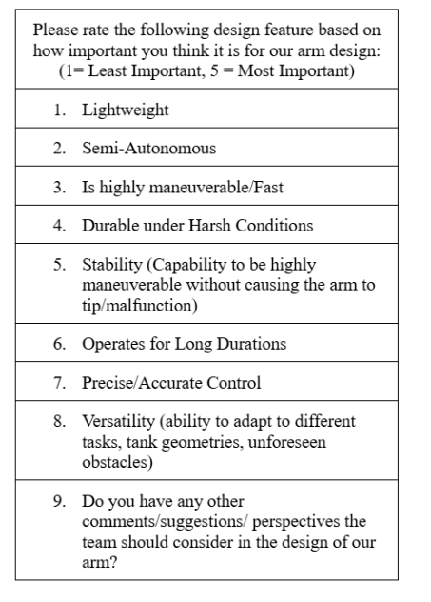
Supplemental Design Survey
13 Respondents of various backgrounds in industry

Slide 9
Customer Interviews
Question | Customer Statement (Rodrigo Ramon) | Customer Statement (Michael Tomlin) | Interpreted Need | Weight | Activity
What specific motions would you expect the robot /robotic arm to handle on a regular basis? (Movement, force) | The robot should be capable of moving back and forth over a specific area during cleaning operations. | The robot needs to perform sweeping motions and accurately identify the edges of curved surfaces on the wall, requiring mathematical precision to navigate these arcs effectively. | The robotic arm must be able to perform repetitive back-and-forth movements over designated areas while also executing sweeping motions to ensure thorough cleaning. | 3 | Executing precise movement patterns to clean specified areas and navigate curved wall surfaces effectively.

Slide 10
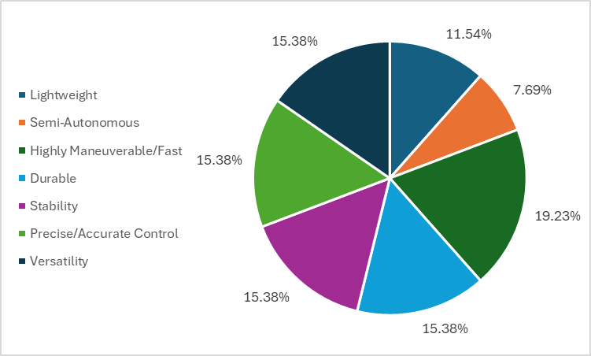
Customer Needs

Slide 11
Customer Needs
Employed various methods, including preliminary research, customer interviews, and supplemental design surveys to identify and rank critical needs
# | Designated Need | Importance Score (1 to 5, 5 = most important)
1 | Highly Maneuverable/Fast | 5
2 | Precise/Accurate Control | 4
3 | Versatile | 4
4 | Durable under harsh conditions | 4
5 | Stable | 4
6 | Lightweight | 3
7 | Semi-Autonomous | 2

Slide 12
System Description
J1 Subassembly
J2 Subassembly
J3 Subassembly
J4 Subassembly
J5 Subassembly
Material Selection
Fastener Selection
Electrical Selection

Slide 13
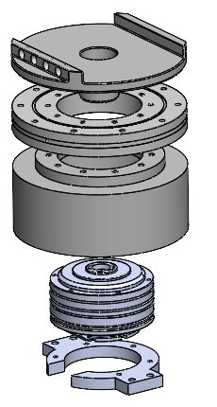
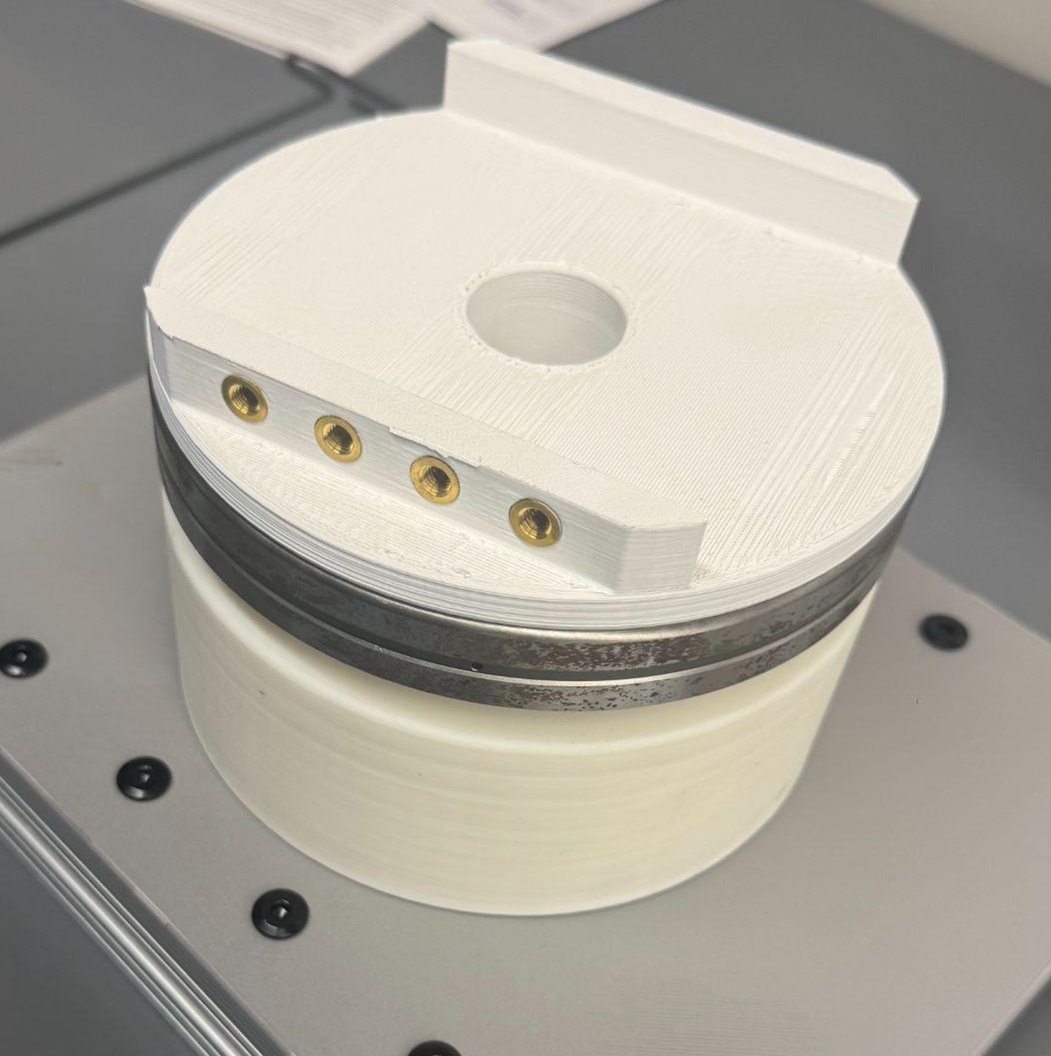
J1 Subassembly
Holds motor and bearing vertically to handle high torque loads
Five components: Motor Holder, Mushroom Cap, Motor Cover, Motor, Cross Roller Bearing
Cross-roller bearing reduces friction and distributes load to prevent motor shaft failure
Uses clearance fit holes (M4-M6) for easy assembly
Adjusted hole tolerance from 0.4mm to 0.6mm for better fastener fit

Slide 14
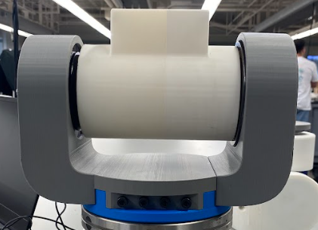
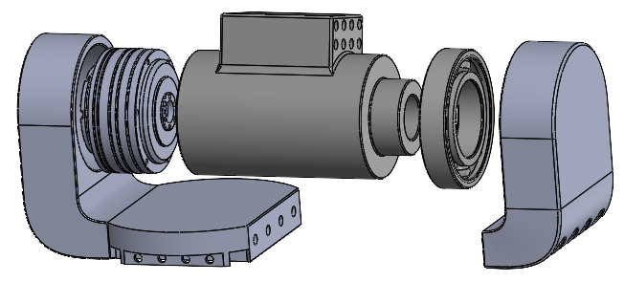
J2 Subassembly
Provides up-and-down movement to expand the arm's workspace
Motor and bearing mounted on opposite sides of a cylinder for connection
Five components: Motor Holder, Motor, Ball Bearing, Bearing Holder, Cylinder
Essential for reaching different heights without repositioning the base

Slide 15
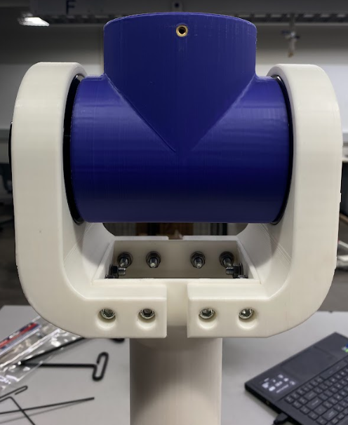
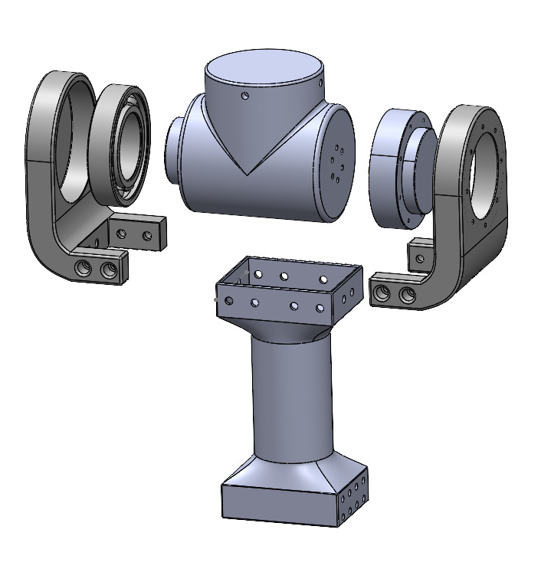
J3 Subassembly
Functions like a human elbow for vertical movement
Six components: Bicep, Motor Holder, Motor, Ball Bearing, Bearing Holder, Cylinder
Uses a similar design to J2 for simplicity
Smaller motor and bearing due to weight constraints
Enhances dexterity and efficiency in robotic motion

Slide 16
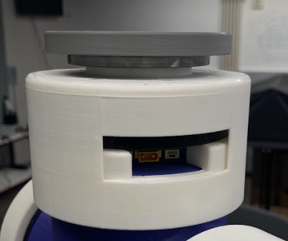
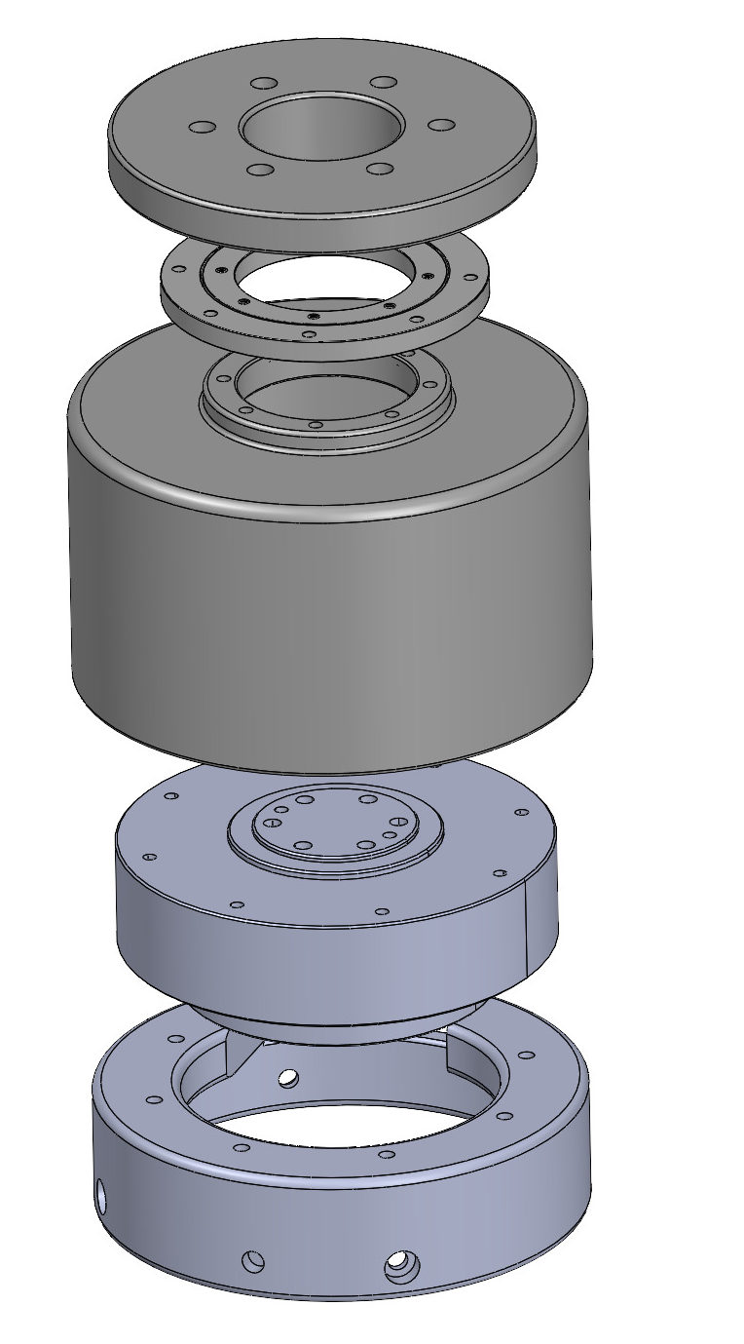
J4 Subassembly
Enables rotational movement similar to a human elbow
Five components: Motor Holder, Motor Cover, Cross Roller Bearing, Mushroom Cap, Motor
Similar function to J1 but connects to J3 Cylinder instead of the base
Uses the same motor as J3 for consistency

Slide 17
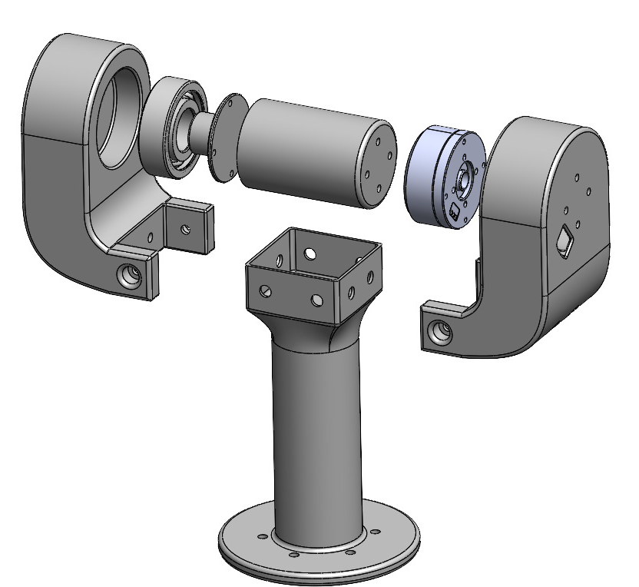
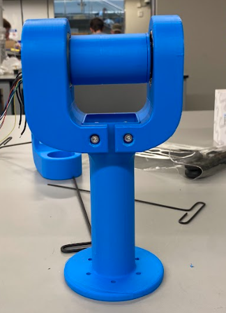
J5 Subassembly
Provides wrist-like up-and-down motion for fine control and dexterity
Seven components: Forearm, Motor Holder, Bearing Holder, Cylinder, Cylinder Cap, Motor, Bearing
Allows end-effector to tilt and interact with objects effectively

Slide 18
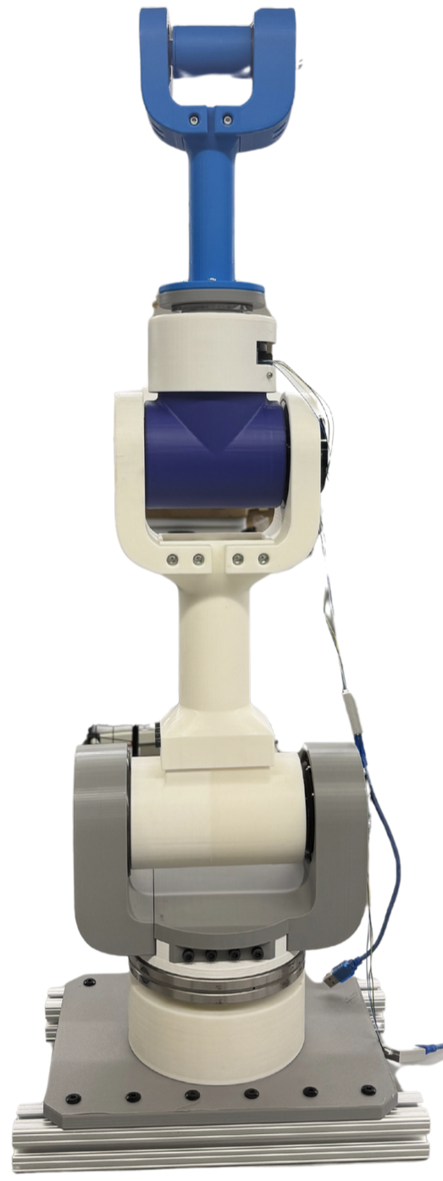
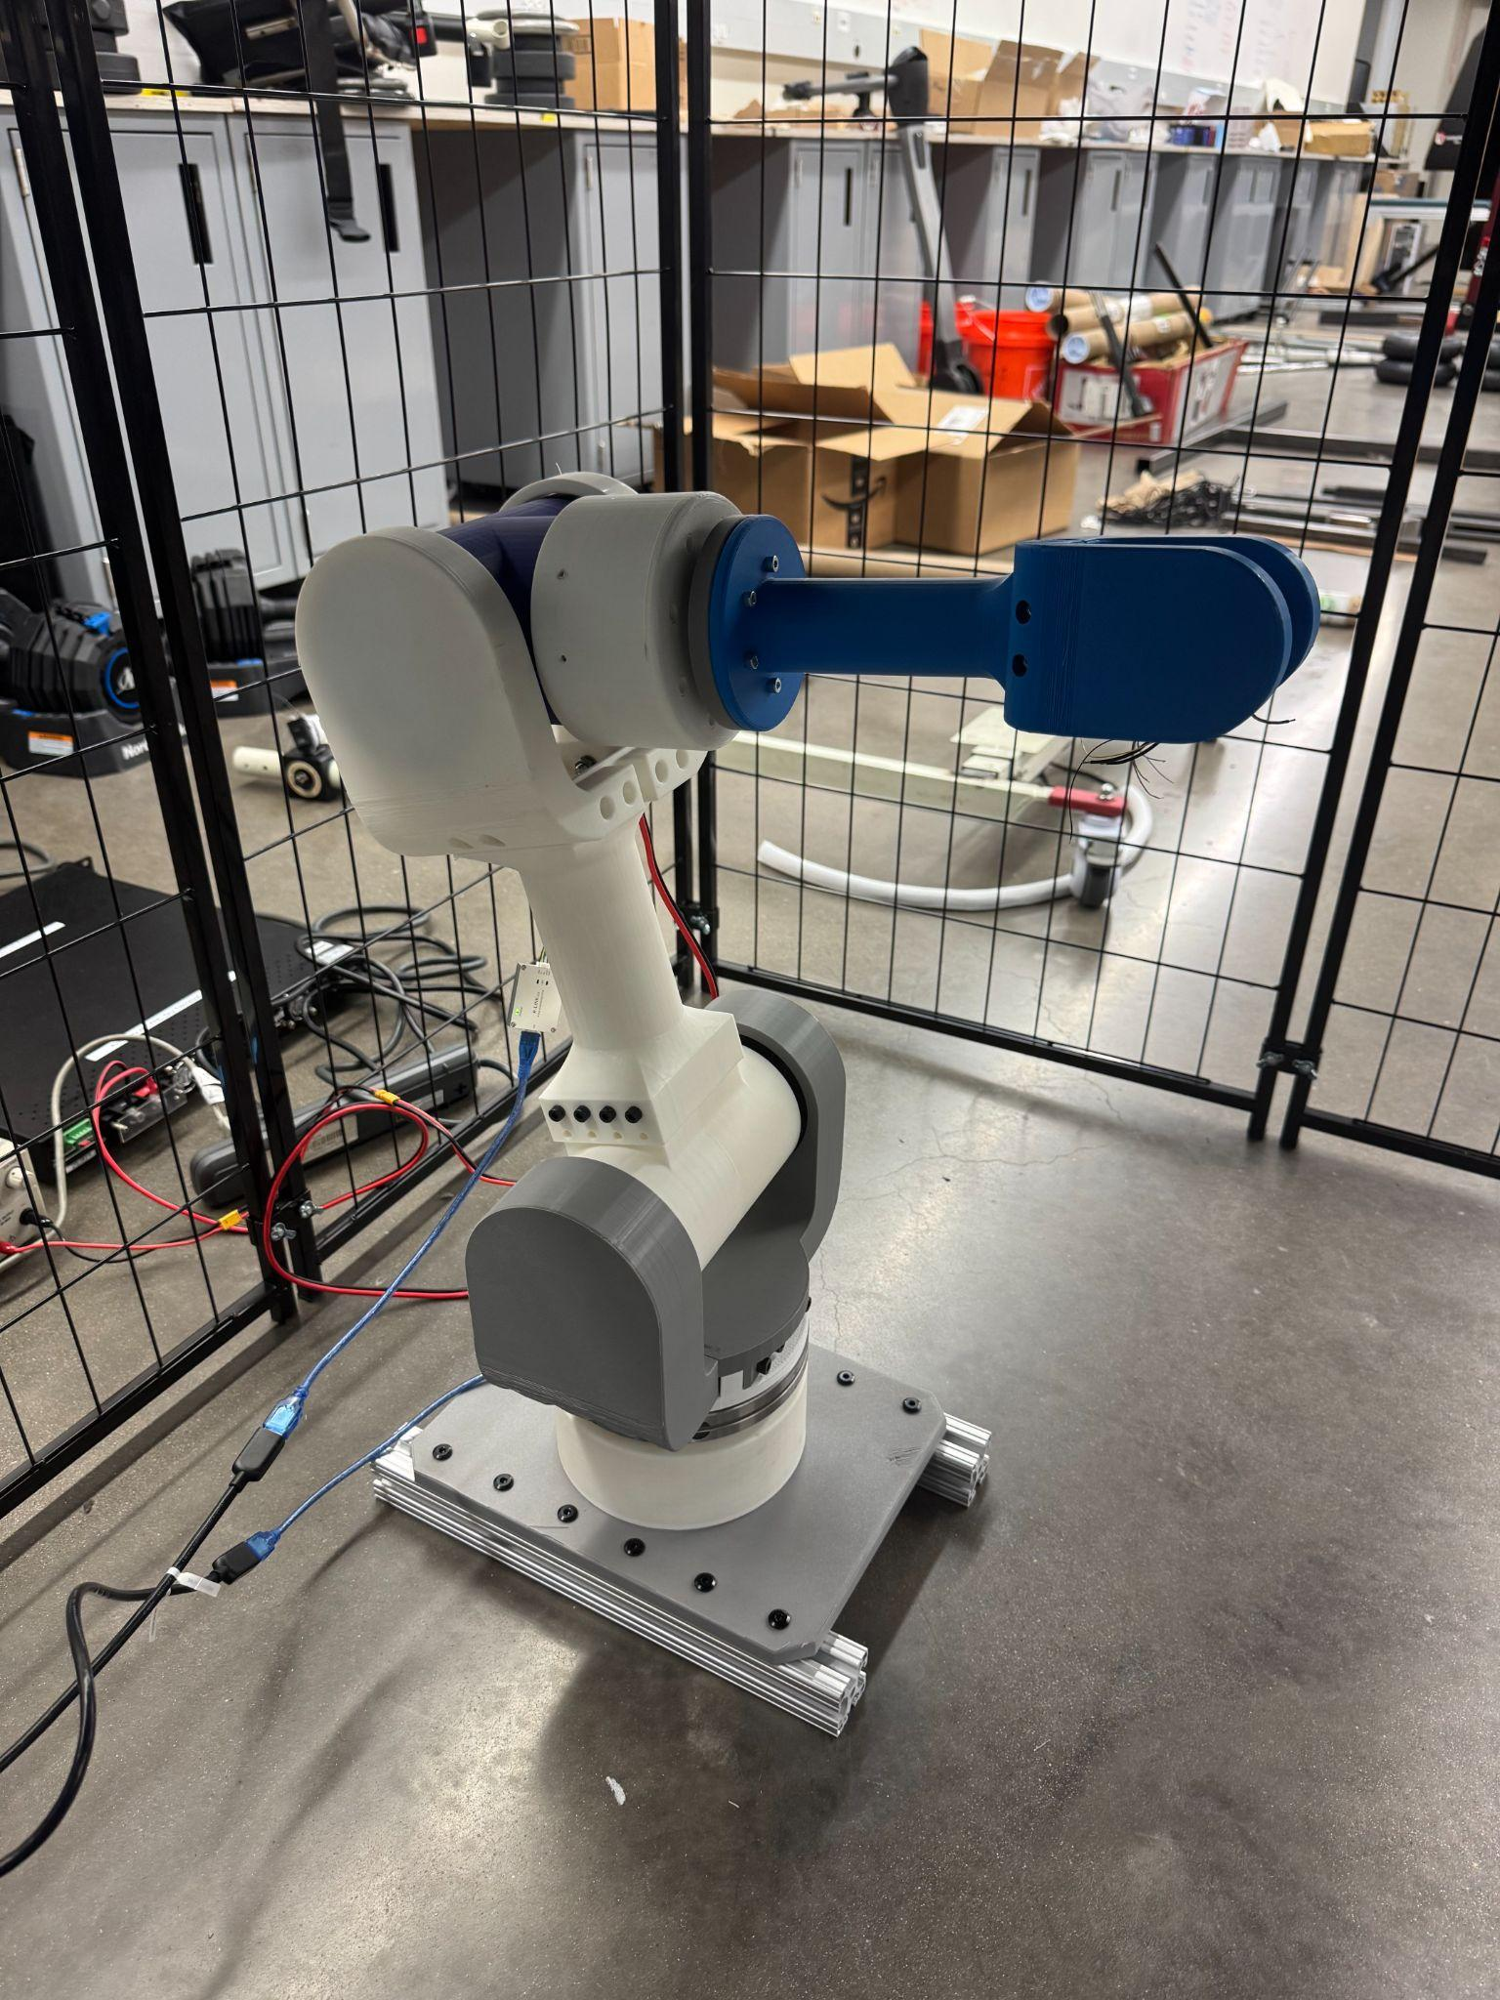
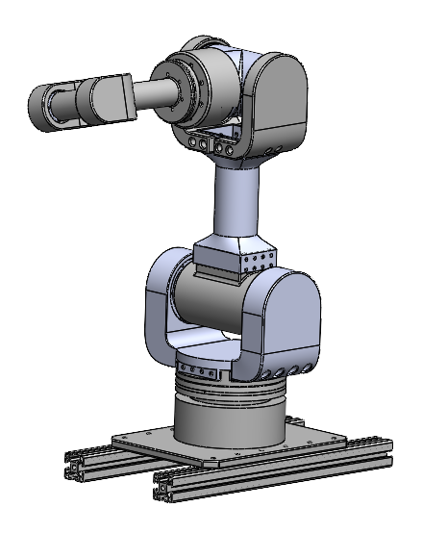
Fully Assembled Robotic Arm

Slide 19
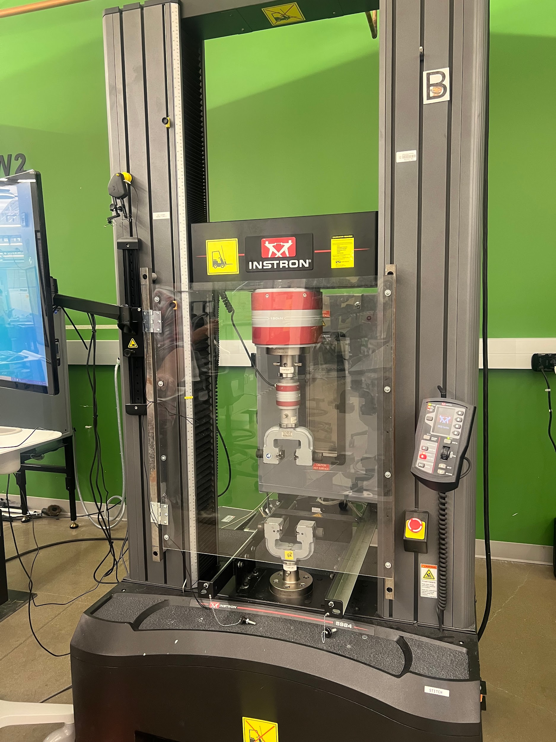
Material Selection
PLA: Used for prototyping due to ease of printing, low cost, and accuracy
Experimental Procedure:
Measured the PLA sample with calipers
Set grips at 25 mm from each end of the sample
Set test speed to 5 mm/min
Measured elongation of sample after plastic deformation was reached
Yield strength of about 14.8 MPA

Slide 20
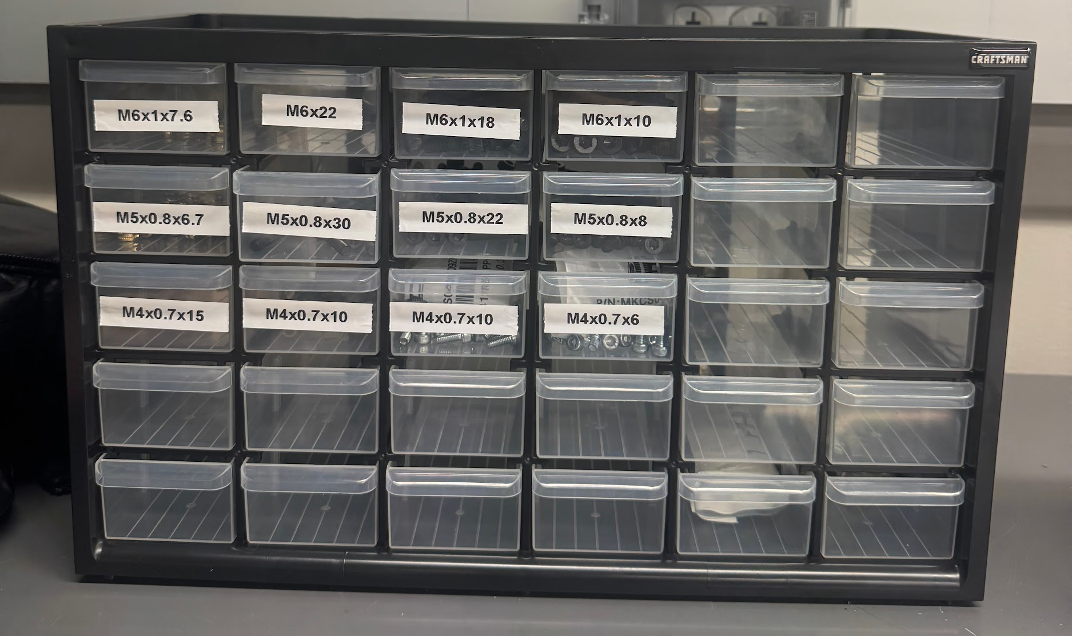
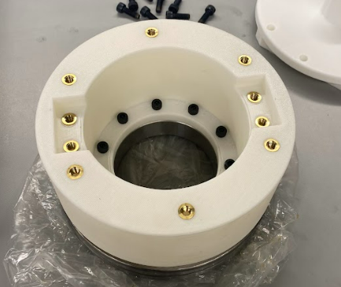
Fastener Selection
Constraints:
Motor Sizing (M2.5 - M6)
Bearing Sizing
Cost Effectiveness
Vibrational Conditions
Identification of Socket Head Cap Screws
High tensile strength - (170,000 psi)
Applicable in High Torque environments
Compatible with heat set inserts in PLA to prevent loosening
Cost ~ 300$
Sizing ~ (M2.5 - M6) & (4 - 30 mm)
Tensile Strength ~ 170,000 PSI

Slide 21
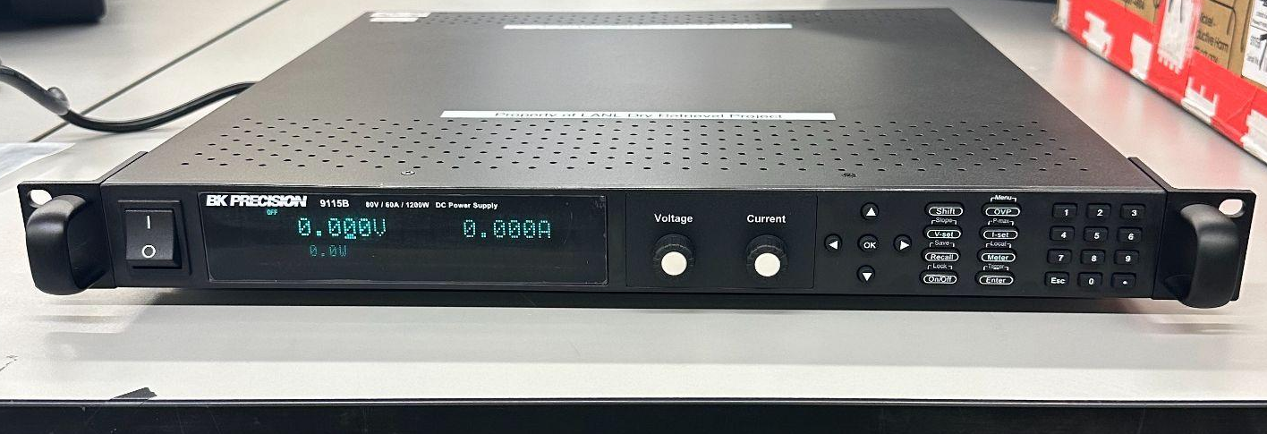
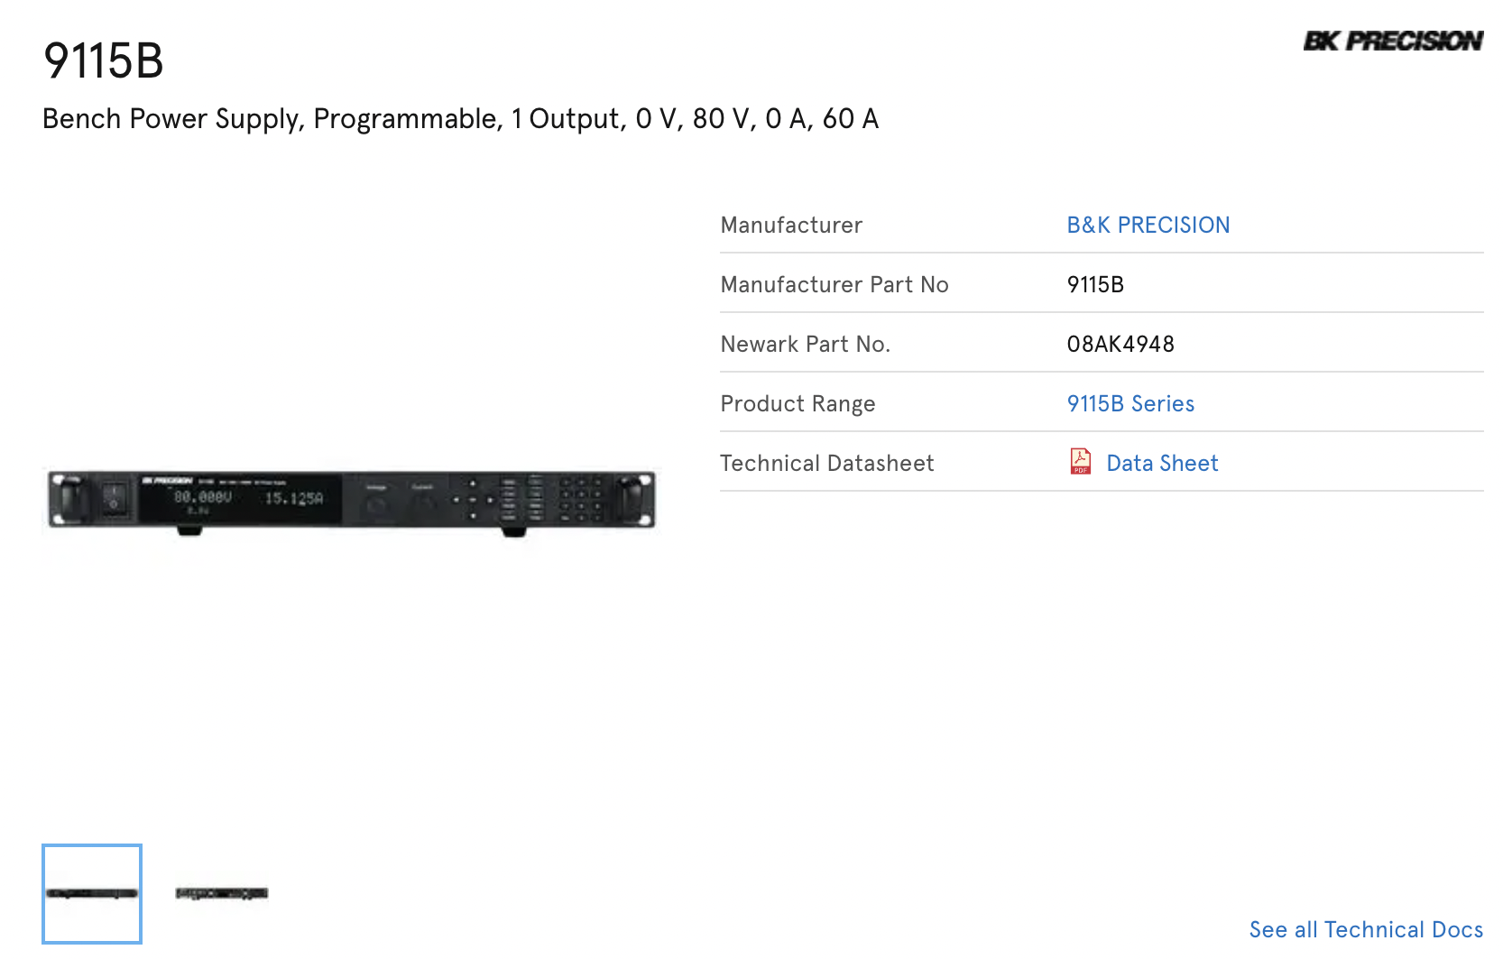
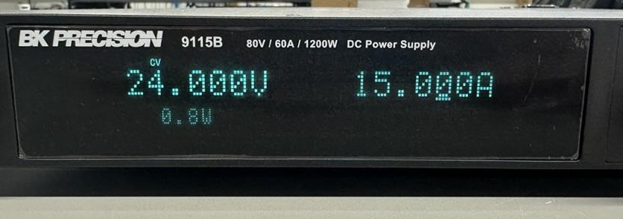
Electrical Selection

Slide 22
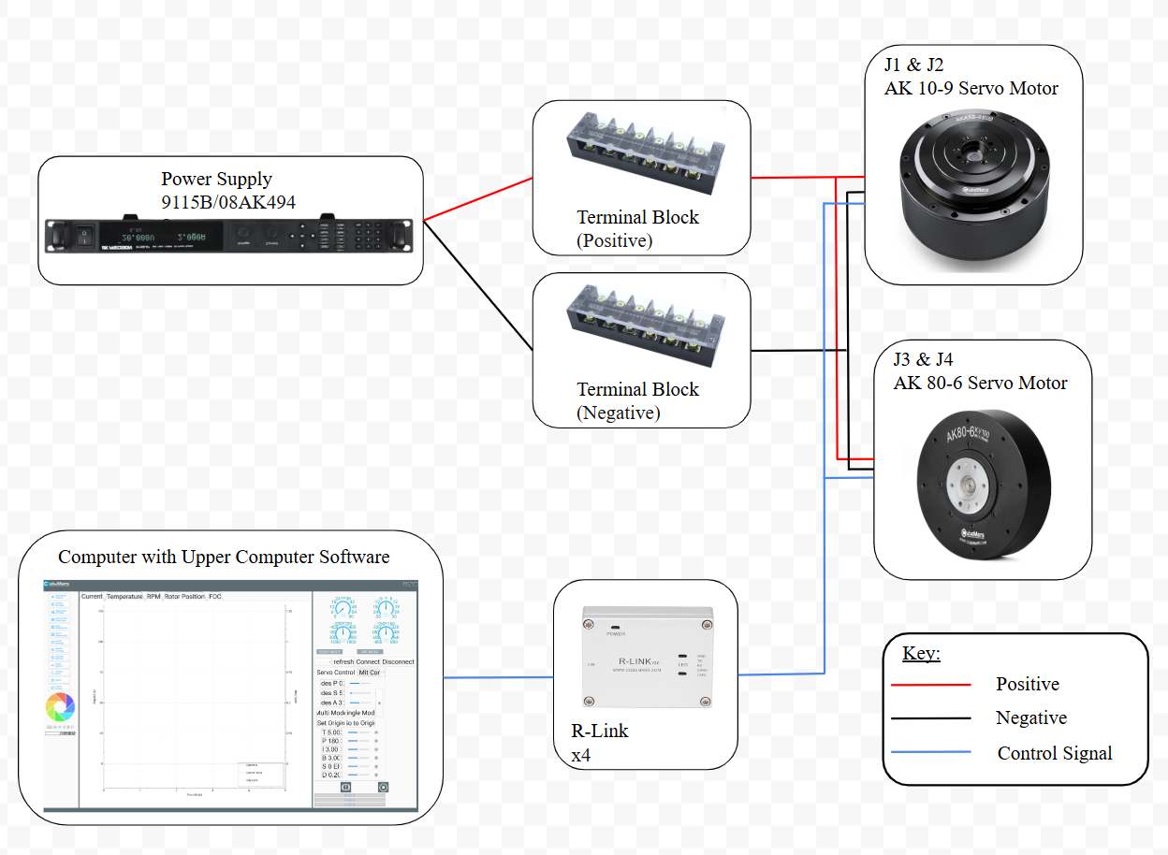
Electrical Selection

Slide 23
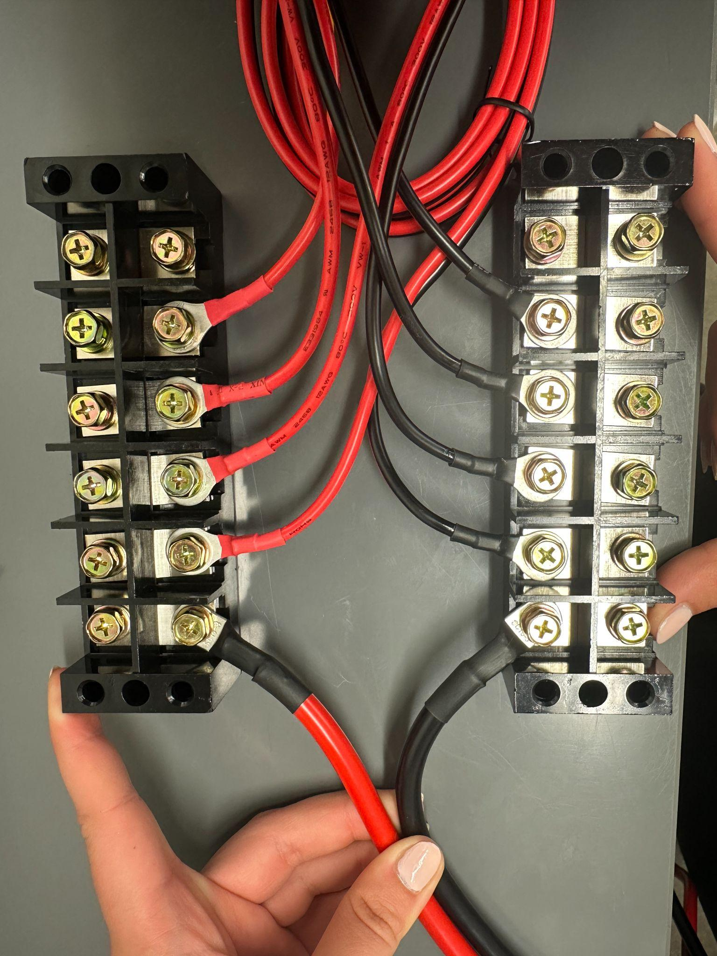
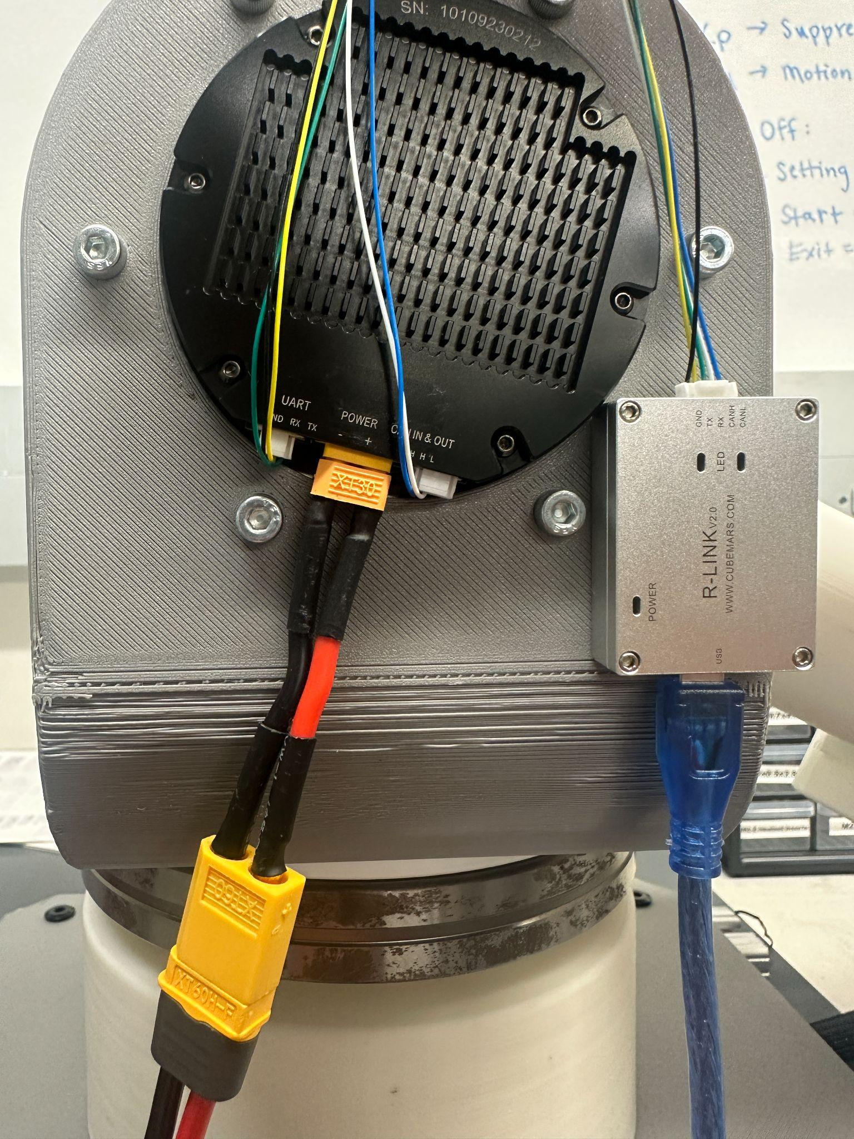
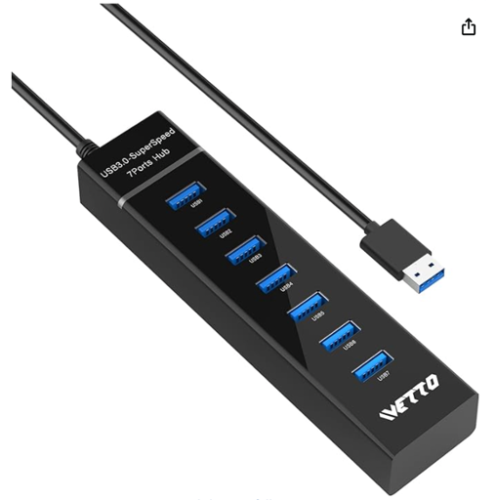
Electrical Selection
XT30 - XT60 Converter
USB to common hub

Slide 24
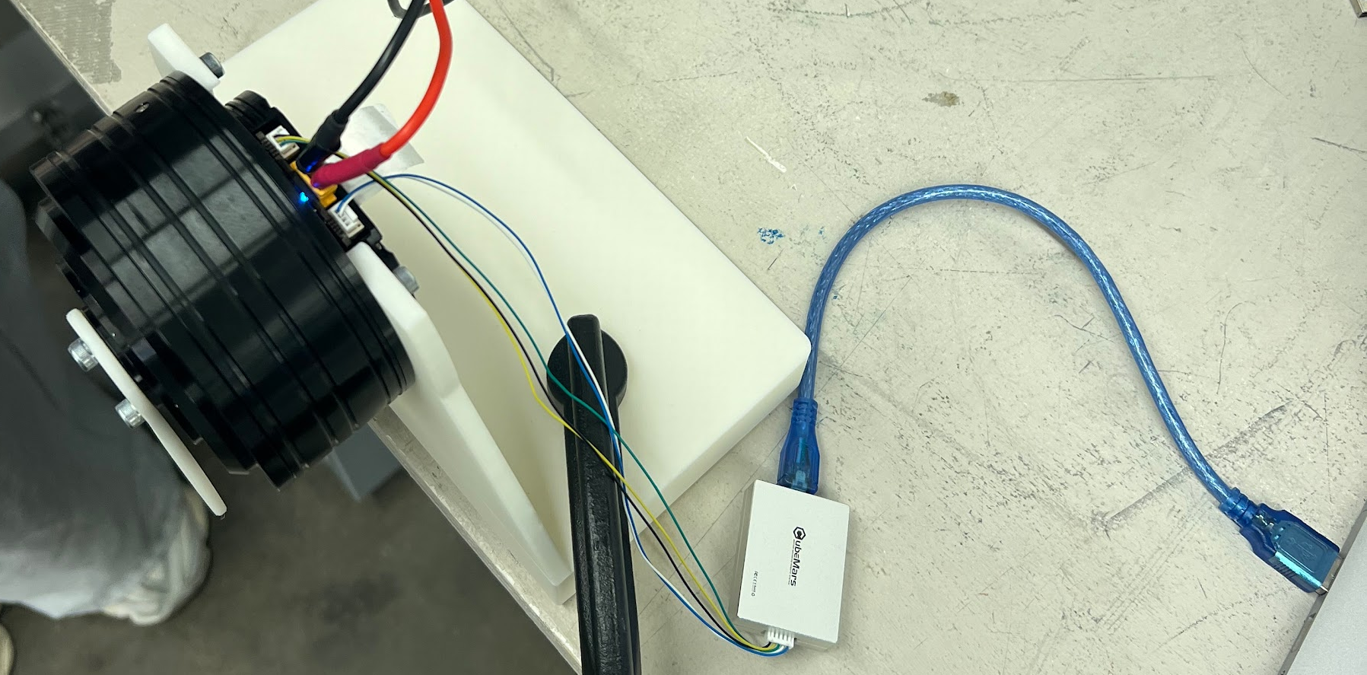
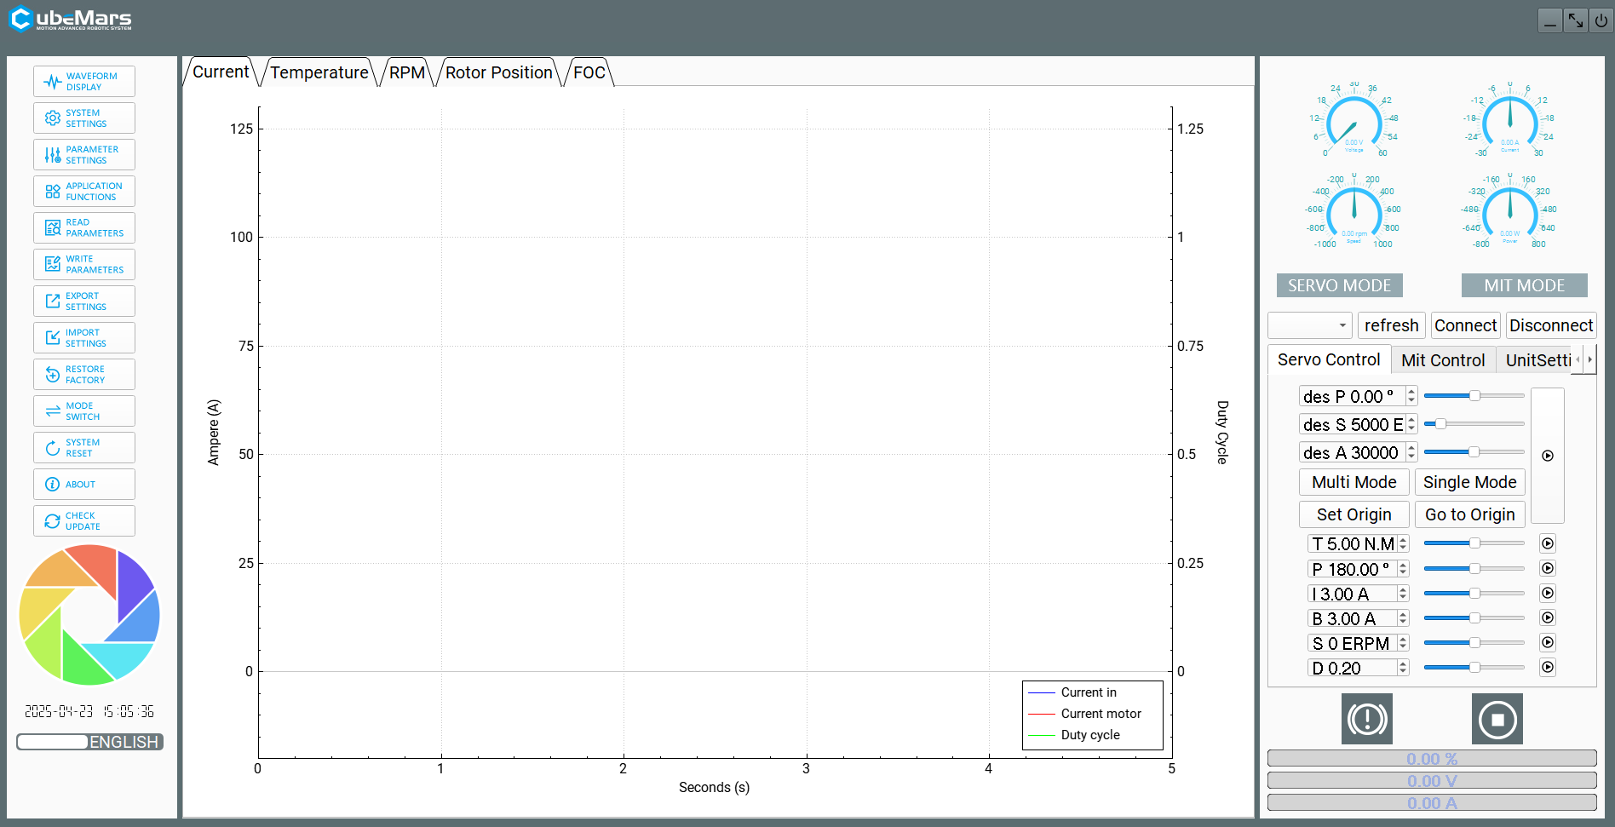
Control Selection
Utilized a CubeMars device called “R-Link”
Serial-to-USB communication device
Facilitates connection to the motors' Upper Computer software for setup and control.

Slide 25
Analysis of Design
Embodiment Design Checklist
Risk Analysis (FMECA and FTA)
DFMA
Design Validation
Comparison of Design
Cost Accounting and Cost Model

Slide 26
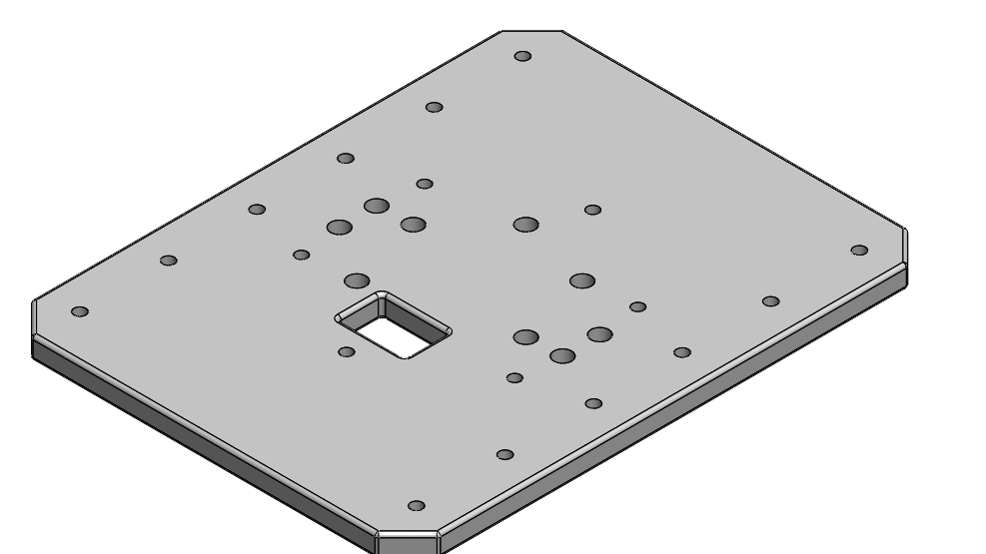
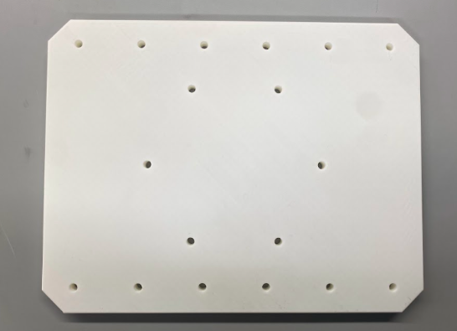
Logistical Challenges Faced
Design Complexity & Iteration:
Realization of design complexity during fabrication
Necessity for iterative redesign of components
Manufacturing & Assembly Issues:
Tolerance issues with threading PLA and heat-set inserts
Importance of infill percentage for 3D-printed part strength
Impact of print orientation on dimensional accuracy
Clearance problems with press-fit fasteners, requiring base redesign
NEW
OLD

Slide 27
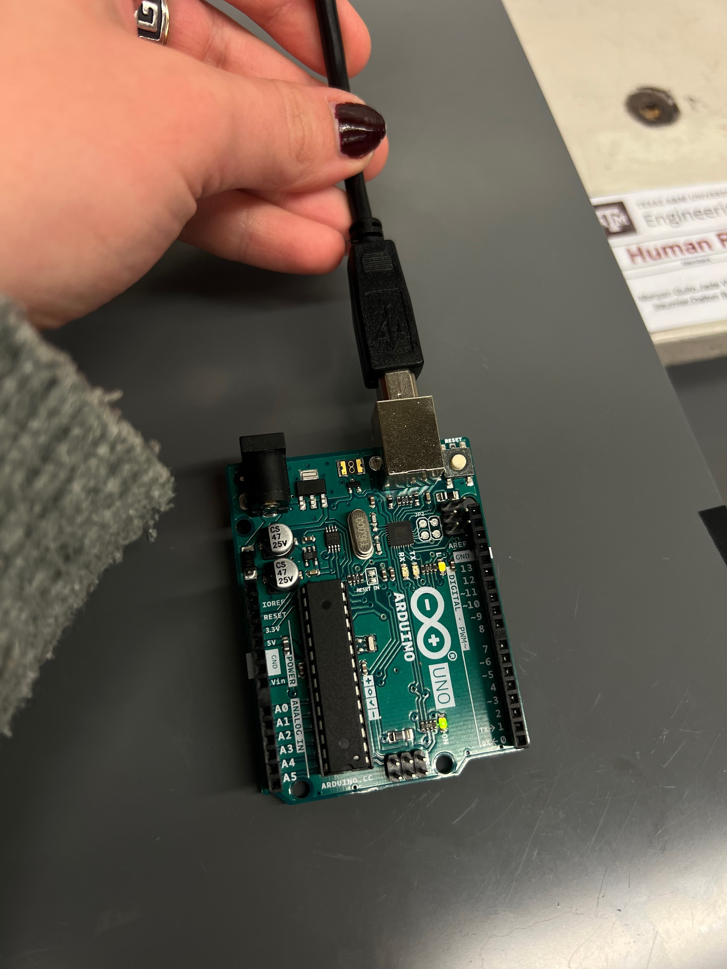
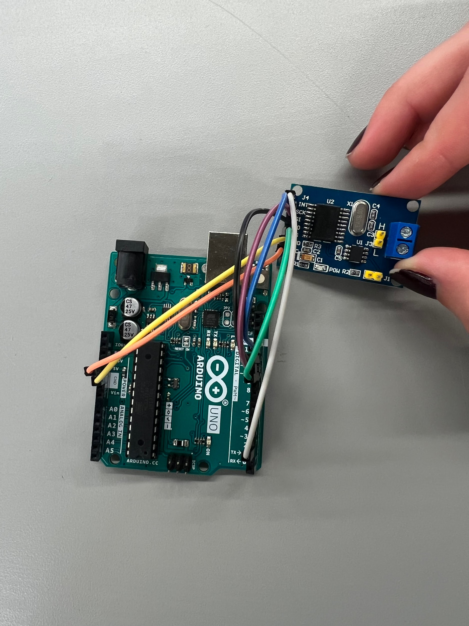
Logistical Challenges Faced
Motor Control Challenges:
Difficulties with Arduino to CAN Bus connection.
Limited C language expertise leading to control delays.
Successful individual motor testing via R-link and upper computer
Goal to continue to troubleshoot the Arduino to CAN connection
Budgeting & Outsourcing:
Unexpected tariff fees impacting project budget. (500$)
Cancel further foreign orders
Successful acquisition of components through LANL sponsorship

Slide 28
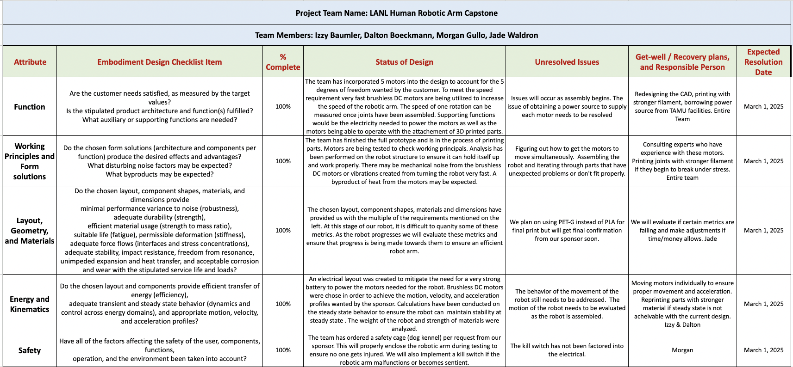
Embodiment Design Checklist

Slide 29
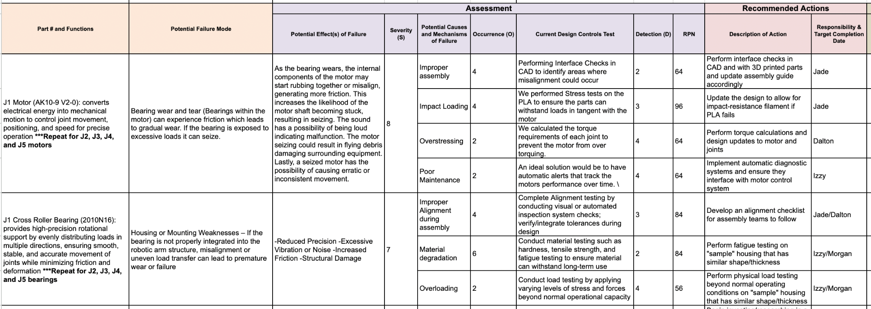
Failure Modes, Effects, and Criticality Analysis (FMECA)

Slide 30
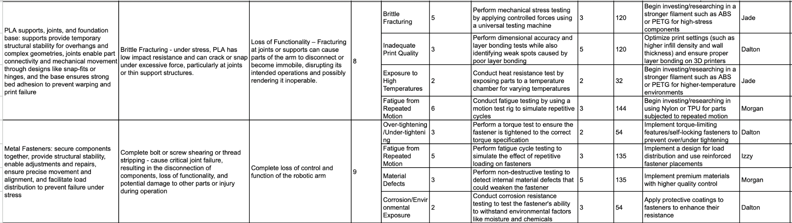
Failure Modes, Effects, and Criticality Analysis (FMECA)

Slide 31
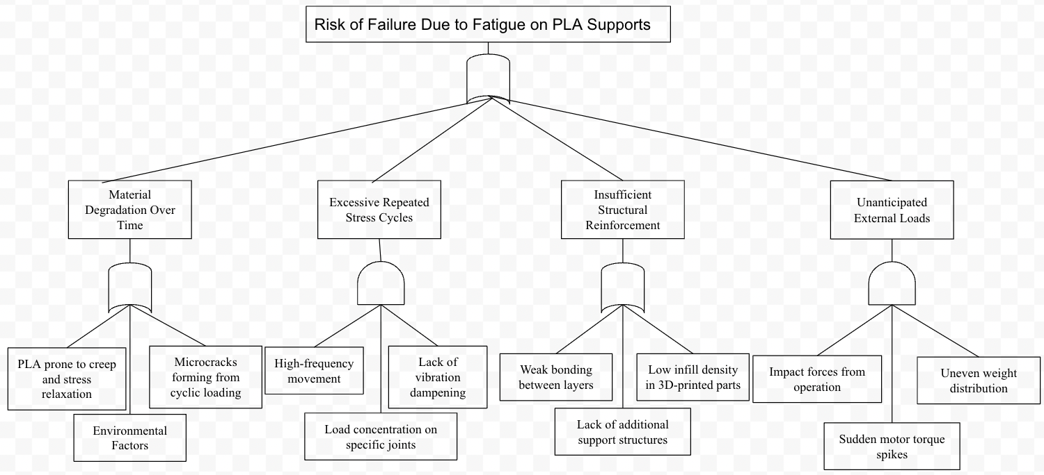
Fault Tree Analysis (FTA)

Slide 32
Standards and Codes
Code | Implication
FMECA- (ISO 10218-2:2025) [7] | Failure mode and effects analysis which provides a systematic process for identifying potential failures in a design, process, or product. Assessing their severity occurrence, detection capability, and actions to mitigate risks. Addresses robots integrated into machinery (robot applications and cells).
Environmental Protection Agency - (40 CFR Part 191) [1] | Disposal systems for spent nuclear fuel or high-level or transuranic radioactive wastes shall be designed to provide a reasonable expectation, based upon performance assessments, that the cumulative releases of radionuclides to the accessible environment for 10,000 years after disposal from all significant processes and events that may affect the disposal system shall
Federal Land Disposal Requirements (40 CFR Part 268) [2] | Generators and treatment facilities that ship mixed waste for disposal at the Hanford Site must do the following to demonstrate compliance with LDR regulations
The Washington State Dangerous Waste Regulations (WAC 173-303) [3] | The Washington State Dangerous Waste Regulations (WAC 173-303) regulate a broader universe of waste than the RCRA regulations and have additional land disposal restrictions. Waste generators and treaters must understand Washington's regulations as they apply to the disposal of waste.
IAEA-TECDOC-672 (Section 4) [4] | Robotic System Applications - Addresses the potential use of robotic technology as it relates to different modes of plant operation
ISO 10218 [5] | Safety requirements for industrial robots
USDL OSHA Standard 1915.181 [6] | Electrical circuits and distribution boards

Slide 33
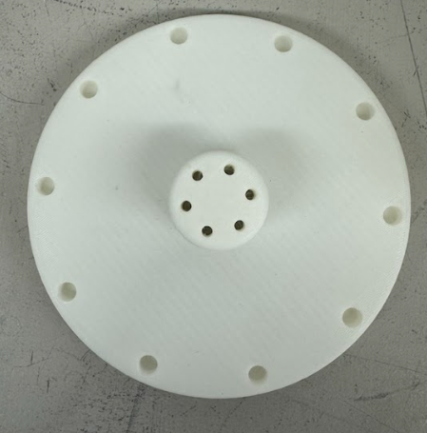
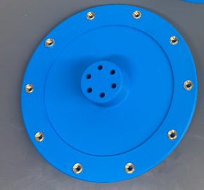
DFMA
Over 40 custom 3D-printed parts across 5 subassemblies prioritized ease of assembly and repeatable manufacturing
Standardized M2.5–M6 screws and used counterbored holes to avoid clearance issues.
Switched from heat-set inserts to open nut-and-bolt method for bicep/forearm to reduce print failures and time spent soldering
Added bearing divots in J1 and J4 to reduce PLA friction and prevent deformation.

Slide 34
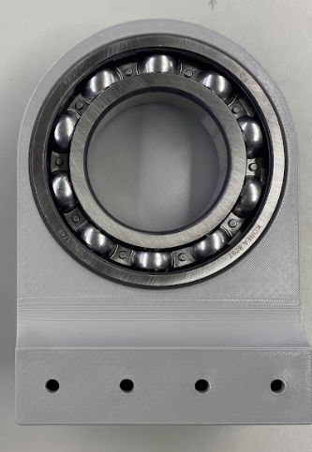
DFMA
Used ~1 mm fit tolerances for ball bearings in J2, J3, and J5 to ensure secure seating.
J1 and J4 share mirrored components; J2, J3, and J5 follow a cylindrical architecture.
Reused motor holders, bearing mounts, and fastener strategies to reduce part variability and streamline prototyping.

Slide 35
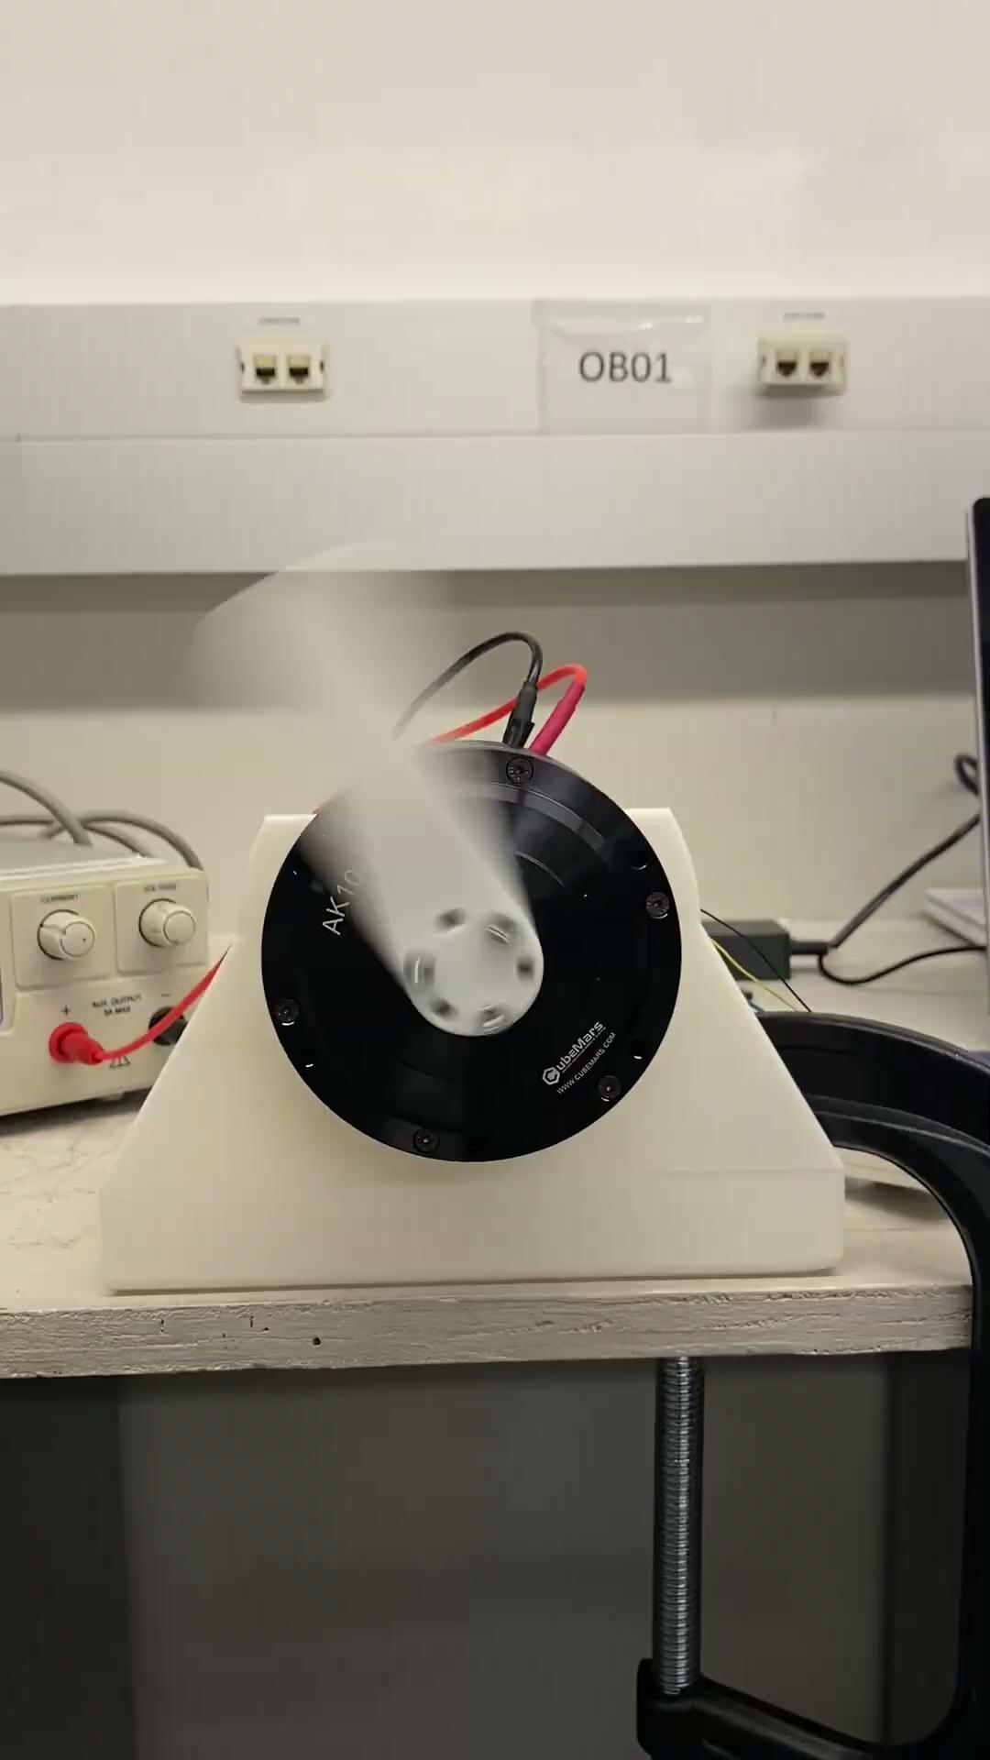
Design Validation: Individual Motor
Motors tested individually and within full assembly.
Target actuation frequency: 1 Hz (6.28 rad/s).
Upper Computer required rad/s, not Hz → all inputs converted.
Control gains tuned for performance:
Position: Kp = 3, Kd = 1 → Fast + stable convergence
Speed: Kp = 0, Kd = 0.5 → Damped motion, minimal overshoot
Torque: Kp = 0, Kd = 0 → Direct current control for holding
Motors tested on a custom stand Verified:
Angular positions: 0°, 90°, 180°, 360°
Speed: Up to 6.28 rad/s
Torque: Verified Motors could output necessary torque
Motors J1–J4 showed consistent, accurate responses via Upper Computer.
Speed - 6.28 rad/s

Slide 36
Design Validation: Integrated
Motors tested in assembly (J1 → J4)
Testing divided into three categories in order to validate the robotic arm at full operation:
Positional Verification: 0°– 360°
Speed Verification: 1 Hz Frequency
Torque Verification: Max Loading Scenario (Full Extension)

Slide 37
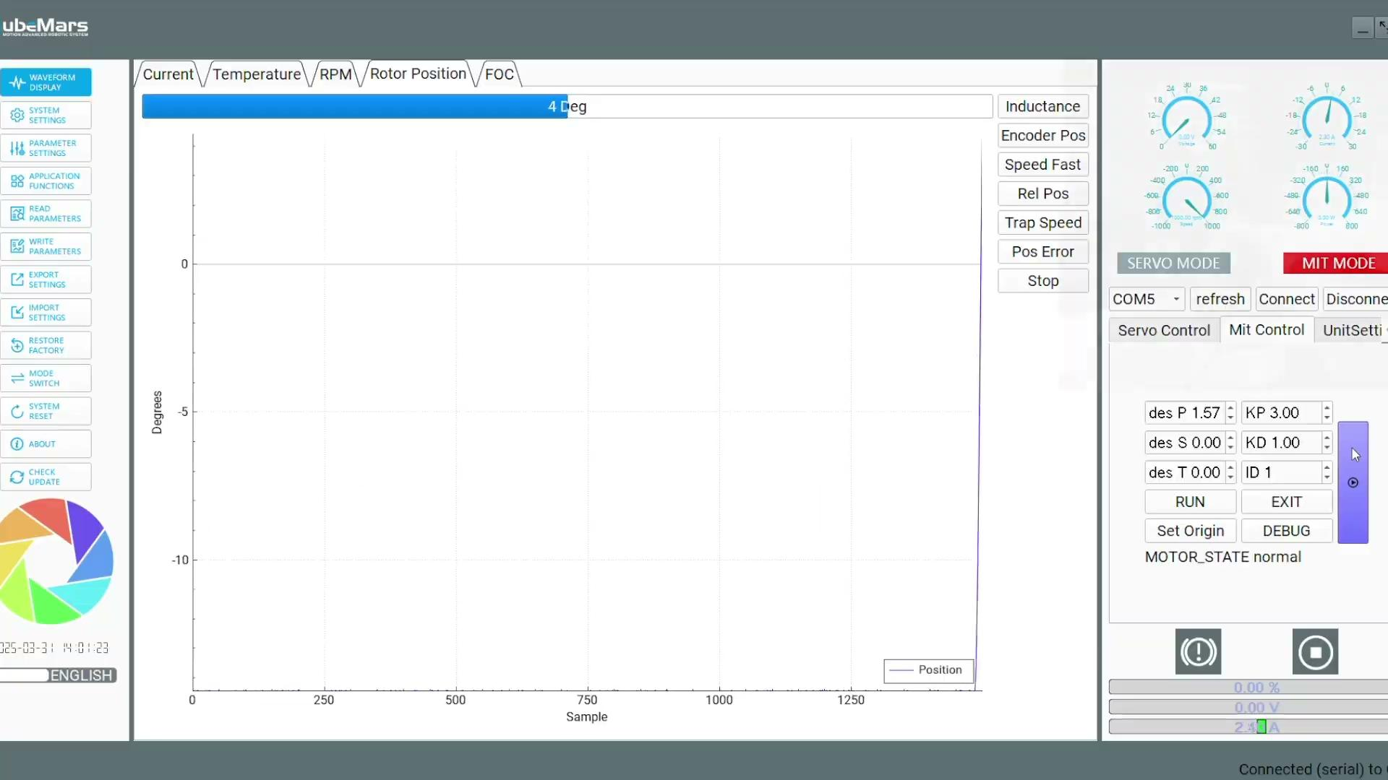
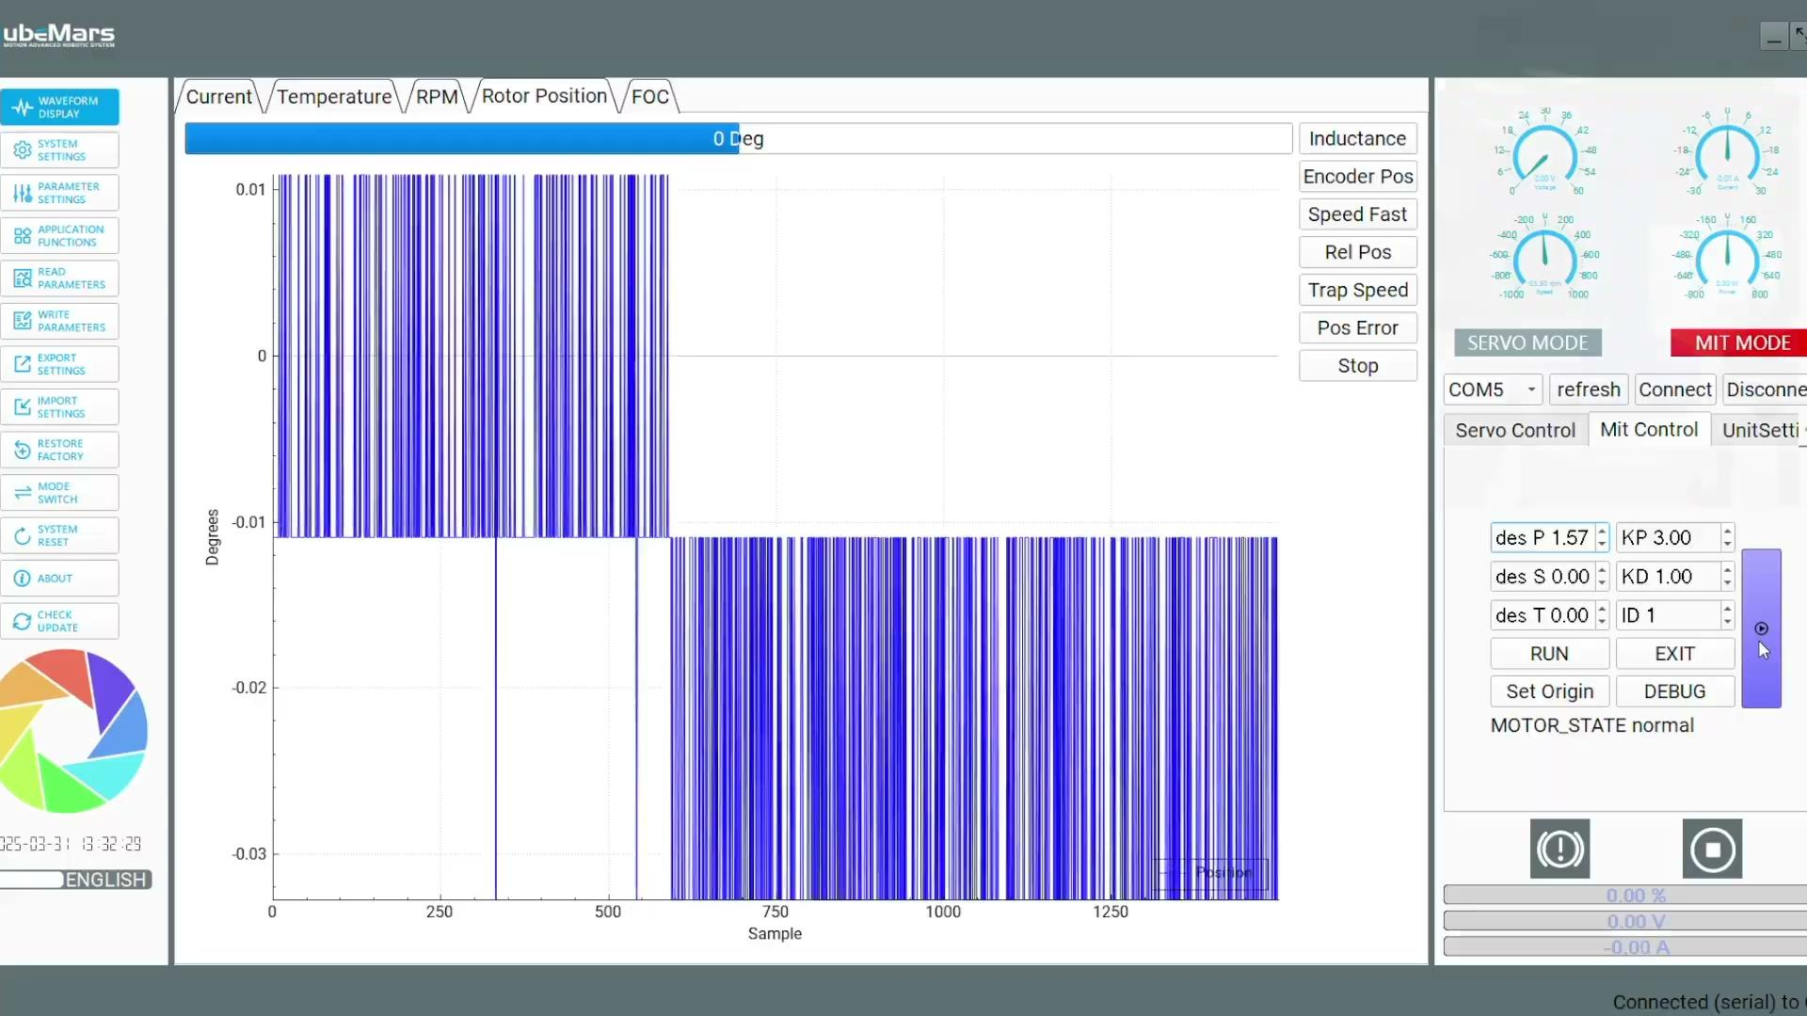
Positional Testing
Each joint was tested across its full range of motion, starting from 0° to the following maximum angles:
J1: 0°– 360°
J2: 0°– 180°
J3: 0°– 180°
J4: 0°– 360°
Consistent ~20° offset was observed during position control testing for all joints.
The deviation across all joints strongly indicated that the issue originated from the Upper Computer, rather than individual joint configuration.

Slide 38
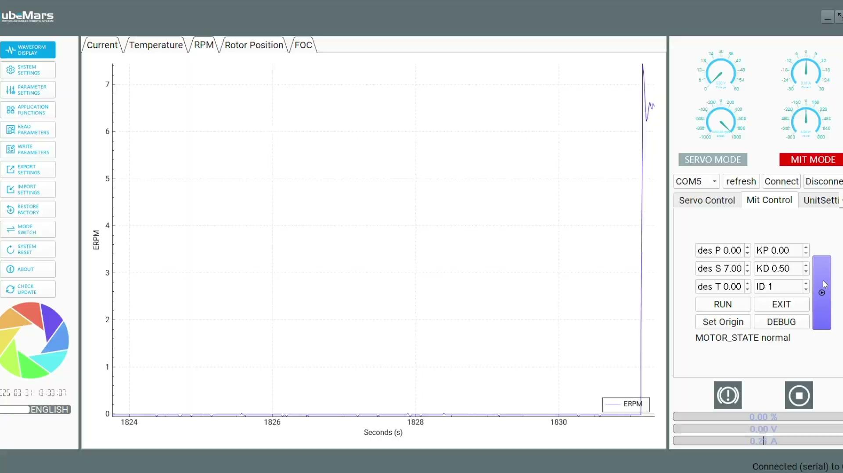
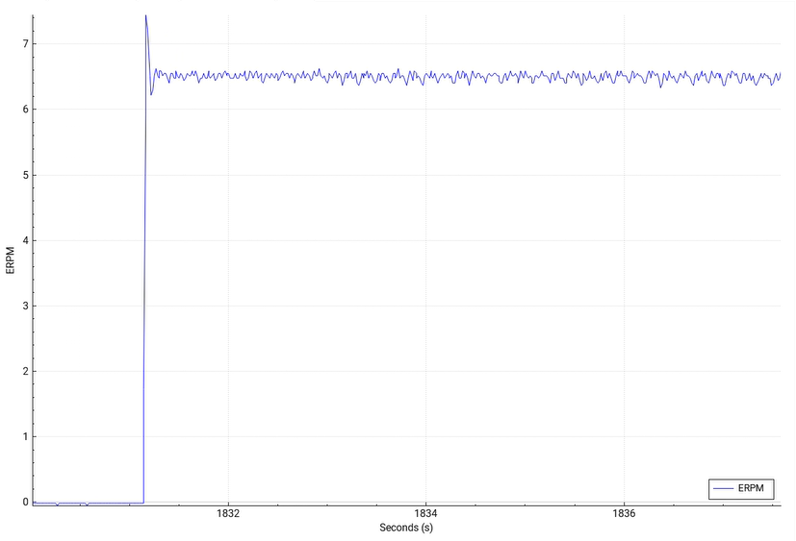
Speed Testing
Speed tested on integrated system using specific motor types (J1 and J4)
J1 and J4 verified to achieve 1 Hz (6.28 rad/s)
Initial tests showed undershoot due to added load from robot assembly
Undershoot was caused by the increased load and resulting torque demand on the motors due to the added mass and inertia of the assembled robot.
Increased iteratively and final output confirmed actual speed matched 1 Hz target

Slide 39
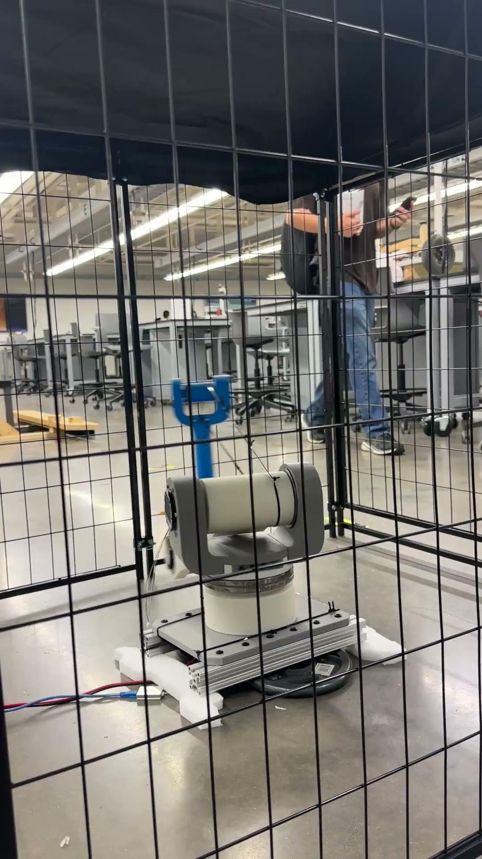
Speed Testing

Slide 40
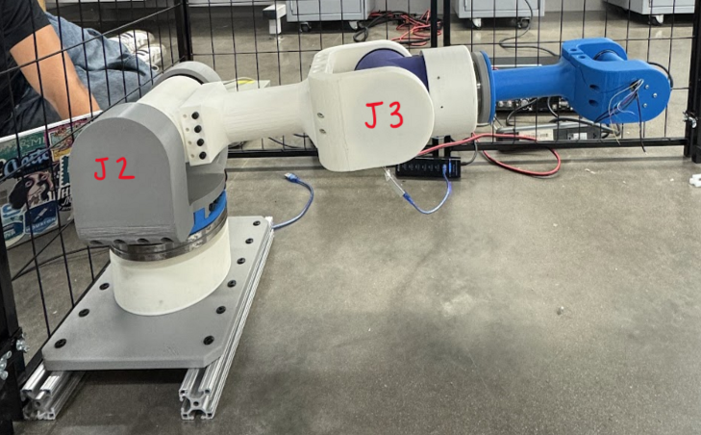
Torque Testing
Robotic arm loading varies significantly in 3D space, making full-case testing impractical
Team focused on worst-case scenario: maximum torque at horizontal full extension (0.72 m)
Joints J2 and J3 identified as most affected under this condition
Torque testing was based on this maximum-load scenario, full extension at 0.7 m
Original payload calculations were used to generate torque input values for the upper computer and verified during testing
Joint | Calculated Torque (N-m) | Actual Torque (N-m)
J2 | 21.33 | 20
J3 | 3.74 | 2

Slide 41
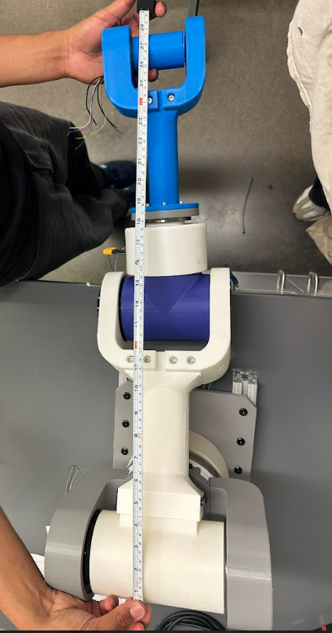
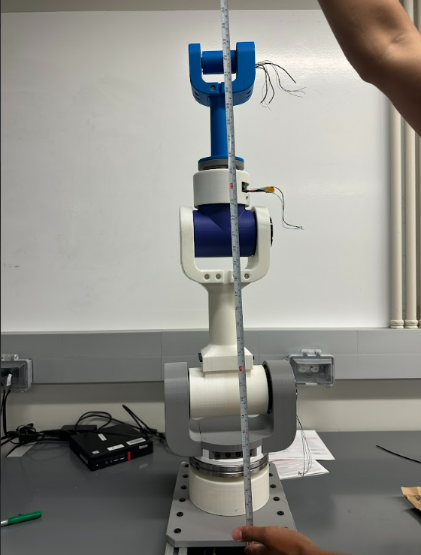

Design Validation
Weight: 11.88 kg (26.2 lb), under the 14 kg max.
Torque:
J2 (high-torque joint): 20 Nm using [AK 10-9 Motor]
J3 (low-torque joint): 2 Nm using [AK 80-6 Motor]
These values confirm our motors can support joint loads, especially in demanding positions.
Accuracy: While mm-level measurements were limited, all motors responded reliably and consistently to positional commands during software-controlled testing.
Reach: Achieved a reach of 0.87 m, exceeding the minimum required (0.67 m).
Mass Distribution: Calculated as 0.132 kg/cm, outperforming the 0.209 kg/cm threshold.

Slide 42
Comparison of Design
All design requirements were satisfied as confirmed through validation testing
Critical sponsor requirements: rapid movement and sustained motion at 1 Hz
Motor tests at each joint confirmed required speed (m/s) and frequency (Hz)
Demonstrated speed, precision, and reliability, fulfilling sponsor’s top priorities
Metric | Required Values | Verified Values | Units
Weight of the Arm | <14 | 11.88 | kg
Minimum Torque Output | 2-10 | 2-20 | Nm
Reach of Robotic Arm | >0.67 | 0.9 | m
System Mass Distribution | 0.209 | 0.132 | kg/cm
Frequency of Motion | 1 | 1 | Hz

Slide 43

Cost Accounting and Cost Model

Slide 44

Cost Accounting and Cost Model

Slide 45
Broader Impact of Design
Lifecycle Design
Intellectual Property (IP)
Liability Considerations
Ethical Considerations/Concerns

Slide 46

Lifecycle Design
Motors:
CubeMars brushless DC motors chosen for low maintenance
Routine checks include visual/electrical inspections, cleaning, and load/environment monitoring
Maintained within –20 °C to 65 °C; wire mesh used to secure connections
Structure & Materials:
Lightweight design prevents motor overload
PLA used for 3D-printed joints
lightweight with high print accuracy but limited durability
Modular Design:
Each joint is independently serviceable for easy motor replacement
Damaged parts can be reprinted using open-source design files
Sustainability:
PLA is industrially compostable
E-waste should be recycled via certified programs

Slide 47

Intellectual Property (IP)
No IP involved (patents, trademarks, copyrights, or trade secrets)
Design is original but not novel or non-obvious enough for protection
Based on industrial designs using commercial parts
Follows standard engineering practices; no unique algorithms or systems
Created for educational use; intended for open academic sharing
Project files are publicly available on GitHub for replication and learning

Slide 48
Liability Considerations
Prototype Liability Considerations
Key risks: pinch points, unexpected motion, mechanical failure
Mitigations:
Safety cage installed for physical protection during testing
Motor torque and speed limited to reduce injury risk
No formal product liability concerns due to educational use at a national laboratory
Production Liability Considerations
Intended use: remote hazardous waste cleanup at a national laboratory
Must comply with federal and state safety regulations (OSHA, DOE)
Potential liabilities:
Injury to personnel
Damage to equipment

Slide 49

Ethical Considerations/Concerns
User Safety:
Treated as the top ethical priority
Safety protocols included limiting speed/torque and using a safety cage
Physical barriers ensured safe prototyping and testing environments
Emphasis on predictable, non-hazardous operation for manual use
Transparency & Honesty:
Performance reporting prioritized throughout development
Regular communication maintained with sponsor via emails and meetings
Weekly updates provided to studio professor during each session

Slide 50
Summary
Work Breakdown Structure
Final Gantt Chart and Project Plan
Technology Development
Limitations
Future Work

Slide 51

Work Breakdown Structure (WBS)

Slide 52

Final Gantt Chart and Project Plan

Slide 53


Technology Development
Challenge Identified:
Unable to control multiple motors at the same time
Required Knowledge for Integration:
Understanding of motion control systems and servo driver configuration
Familiarity with feedback loops and communication protocols
(e.g., CAN bus)
CAN Bus & Arduino for Multi-Motor Control:
CAN bus enables communication between Arduino and multiple motors using unique CAN IDs
Requires a CAN transceiver like the MCP2515 module
Arduino sends commands using libraries like MCP_CAN_lib to control speed/position
Future Implementation:
Enables real-time, synchronized, and scalable motor control for complex systems

Slide 54

Technology Development
Challenge Identified:
GL40 Gimbal Motor incompatibility with the R-link device
Resulted in inability to operate the fifth joint of the robotic arm
Recommended Components (by Elmo Motion Control):
G-DCWHI2.5/100SESQ – High-performance servo driver
CBL-GDCWHIKIT02 – Wiring kit designed for the servo driver
Future Implementation:
Allows future teams to power and control the gimbal motor
Ensures full functionality of the robotic arm’s fifth joint

Slide 55

Technology Development
Challenge Identified:
Wiring limited 360° rotation, risking entanglement and interrupting power to brushless DC motors
Resolution Steps:
Identified need for a split-ring to maintain continuous electrical connection during rotation
Ensured stable power and signal integrity for smooth, unrestricted motion
Future Implementation:
Custom design a split ring to fit the robotic arm’s specs
Integrate into future builds to enable full motion and protect wiring

Slide 56


Limitations: Mechanical and Structural
Single-Joint Control only – current software allows only one motor to move at a time, preventing smooth, multi-joint coordination
Limited durability – Due to use of PLA components, the arm is not suitable for high-radiation or high-temperature environments. The PLA might struggle under high torque loads as well.
No integrated end-effector
Structural performance not yet verified under prolonged cyclic loading or high-vibration conditions

Slide 57

Limitations: Control and Wiring
Limited Force Control – Operation is restricted to MIT mode for safety, full capabilities in servo mode remain untested due to risk
External Cable Routing/Cable Management – wiring constraints joint motion, reduces workspace, and increases the risk of entanglement or damage
No gravity compensation – arm lacks real time torque adjustment for gravity, extensive manual tuning is required for different movements and loads

Slide 58



Future Work: Control and Functionality
Utilize multi-joint control algorithms to enable coordinated movement across all 5 degrees-of-freedom
Incorporate sensors for feedback-driven control
Refine control system architecture to allow for real-time user interface and potential joystick control
Explore safe operation in servo mode by designing advanced control algorithms
Integrate closed-loop feedback for smoother, more adaptive control during tasks

Slide 59

Future Work: Mechanical and Structural
Upgrade structural components to radiation resistant materials
Conduct durability and fatigue testing to assess performance under prolonged use
Implement real-time gravity compensation based on arm pose and motor feedback
Redesign for internal cable routing to expand range of motion
Design and integrate a task specific end-effector, such as a cleaning brush or scraping tool

Slide 60


Assembly Manual
Assembly Manual complete
~60 pages long (lots of figures, cover pages, etc…)

Slide 61


GitHub

Slide 62
Acknowledgements
Dr. David Mascarenas – Project sponsor; provided key guidance and support throughout
Dr. Swaroop Darbha – Early mentorship in systems thinking and design foundations
Dr. Ya Wang – Offered support during prototyping/assembly and testing phases
Rapid Prototyping Studio – Prototyping of 3D-printed components
FEDC – Provided tools and equipment for prototyping
Zachry Bucknor-Smartt & Vidur Zimmerman – Design feedback that improved structure and performance

Slide 63

Thank You!
Final Design
1st Design

